Slide 1
Tuning in to God’s Language: Christian Dream Interpretation
Dream – “A sequence of images, etc. passing through a sleeping person’s mind.” (Webster)
Vision – “A mental image” (Webster)
A close connection in the Hebrew – Job 33:15-16
Daydreaming is man utilizing the visionary process

Slide 2
Tuning In to God’s Language: Christian Dream Interpretation
Job 33:14-16 For God may speak in one way, or in another, Yet man does not perceive it. In a dream, in a vision of the night, When deep sleep falls upon men, While slumbering on their beds, Then He opens the ears of men, And seals their instruction.

Slide 3
Scientific Observations
Everyone dreams one to two hours each night during the alpha level
The 90 minute cycle of sleep (see next slide)
REM – Rapid Eye Movement
No dreaming = nervous breakdown
Dreams = guardians of our mental and emotional well-being

Slide 4
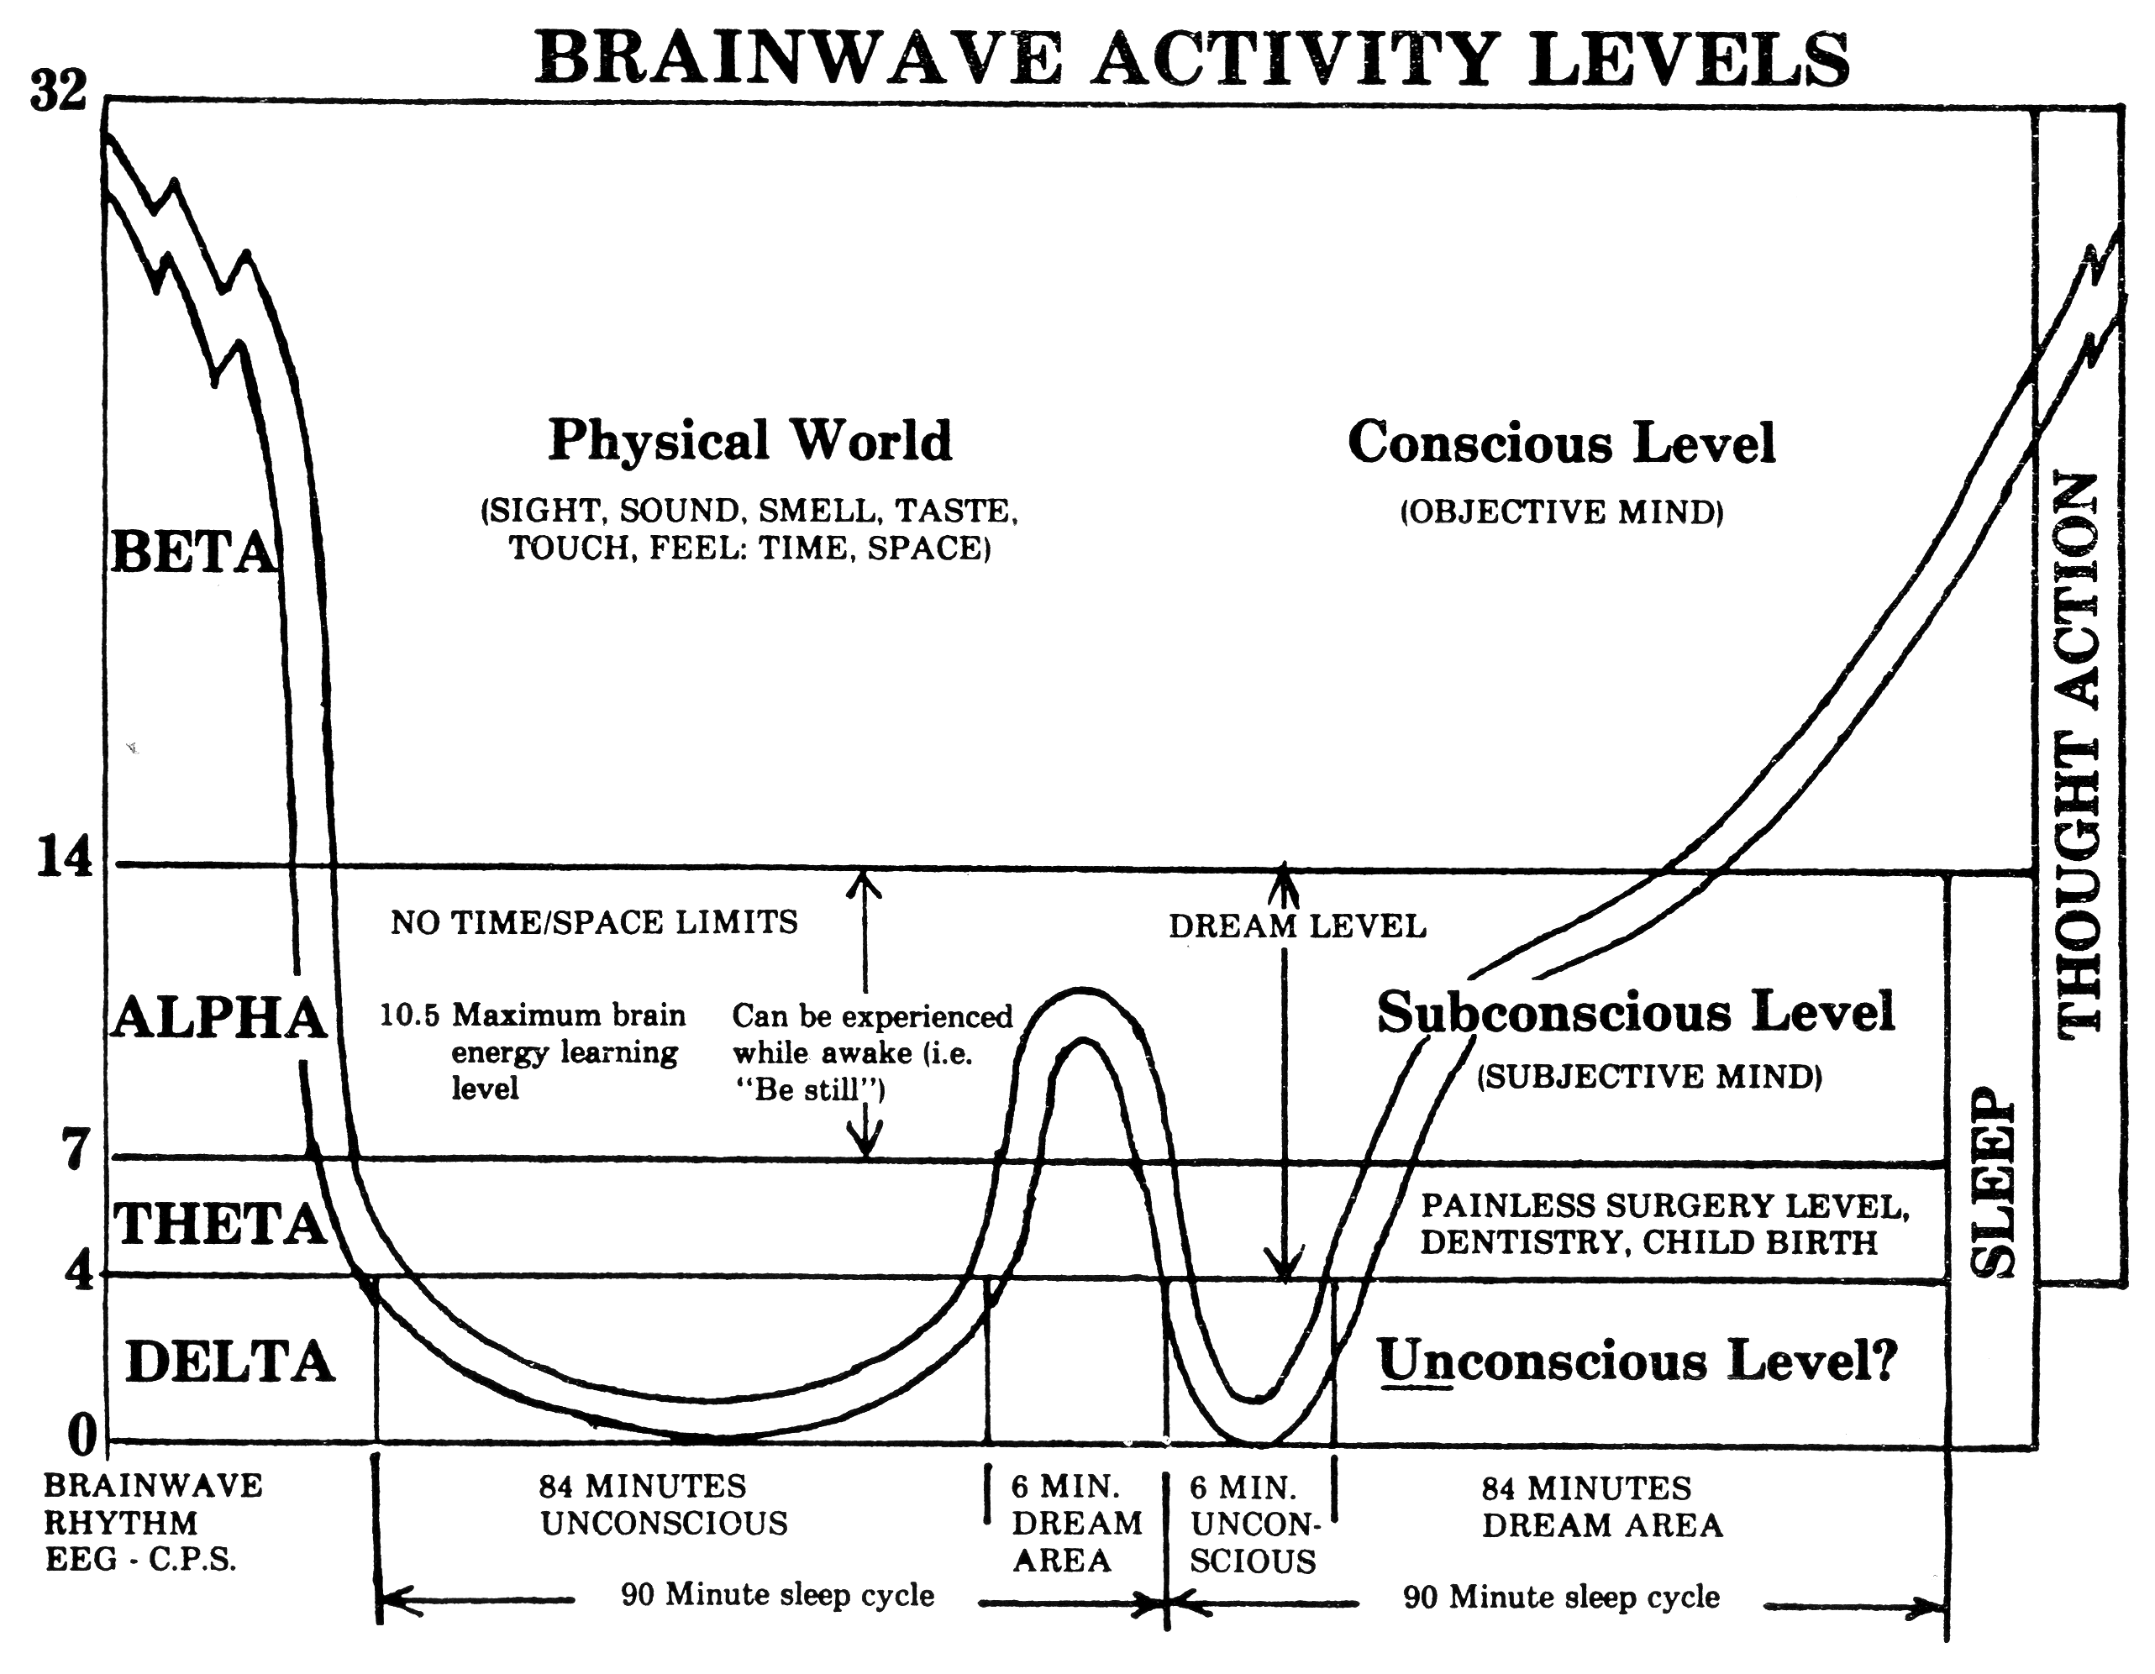

Slide 5
Seven Reasons We Should Listen to Our Dreams
God declared that He WOULD speak through dreams and visions in the Old Testament (Numbers 12:6).
God declared that He DID speak through dreams and visions in the Old Testament (Hosea 12:10).
God declares that He WILL communicate through dreams and visions in the New Testament (Acts 2:17).
God declares that He WILL COUNSEL us at night through our dreams (Psalm 16:7 NASB).

Slide 6
Seven Reasons We Should Listen to Our Dreams
Genesis 15:1 - After these things the word of the LORD came to Abram in a vision, saying, "Do not be afraid, Abram. I am your shield, your exceedingly great reward."
Genesis 15:5 - Then He brought him outside and said, "Look now toward heaven, and count the stars if you are able to number them." And He said to him, "So shall your descendants be."

Slide 7
Seven Reasons We Should Listen to Our Dreams
Genesis 15:12-13,18 - Now when the sun was going down, a deep sleep fell upon Abram; and behold, horror and great darkness fell upon him. Then He said to Abram: "Know certainly that your descendants will be strangers in a land that is not theirs, and will serve them, and they will afflict them four hundred years... On the same day the LORD made a covenant with Abram, saying: "To your descendants I have given this land, from the river of Egypt to the great river, the River Euphrates

Slide 8
Seven Reasons We Should Listen to Our Dreams
Rather than our dreams being fatalistic, dreams are calling us to change SO WE WILL NOT PERISH (Job 33:14-18).
God does very significant things WITHIN dreams. For example, He established the Abrahamic Covenant in a dream. (Genesis 15:12,13,18).
God grants supernatural gifts THROUGH dreams and visions in the Old Testament (Numbers 12:6).

Slide 9
Seven Reasons We Should Listen to Our Dreams
1 Kings 3: 5, 9, 12, 15 - At Gibeon the LORD appeared to Solomon in a dream by night; and God said, "Ask! What shall I give you?"... "Therefore give to Your servant an understanding heart to judge Your people, that I may discern between good and evil. For who is able to judge this great people of Yours?“… "behold, I have done according to your words; see, I have given you a wise and understanding heart, so that there has not been anyone like you before you, nor shall any like you arise after you."... Then Solomon awoke; and indeed it had been a dream.

Slide 10
Five Ways to Recall Your Dreams
Say to yourself, “I believe dreams contain a valid message.”
Ask God to speak to you through dreams as you fall asleep.
Put your journal beside your bed and immediately record your dreams upon awakening!
Get eight hours of sleep, as the entire last hour will be dream-time.
Awaken naturally. Alarms and such can shatter dream recall.

Slide 11
Seven Foundational Principles for Interpreting Dreams
Most dreams are symbolic.
The symbols come from the dreamer’s life.
The dream generally speaks of the concerns which your heart is currently facing.
The meaning of the dream must be drawn from the dreamer.
The dreamer’s heart will leap and “witness” and say, “Aha!” with the correct interpretation.

Slide 12
Seven Foundational Principles for Interpreting Dreams
Dreams reveal but do not condemn.
Never make a major decision in your life based only on a dream.

Slide 13
Four Fast Track Questions for Interpreting Dreams
Who or what is the dream about, and what area of your life does it refer to?
Is the dream positive or negative, and noticing the color, is it bright or dark?
Are there any repeated themes, or is it a Common Dream?
What are the three to four main points of the dream?

Slide 14
Discerning Dreams About Yourself
At least 95% of your dreams will be about you!
Your dreams come from your heart.
Emotional issues, heart struggles, body and health problems will be expressed symbolically through your dreams.
Your dreams will also point out relational issues, circumstances and events as well as ministry and vocation situations.

Slide 15
Discerning Dreams About Yourself
Since the vast majority of dreams are about your inner self, begin the process of interpretation with the assumption that it probably is about something you are or should be dealing with in your own life right now!

Slide 16
Discerning Dreams About Yourself
Isolate the feeling of the dream first.
Look at the action of dream next.
The people in your dreams often represent characteristics about you.
Animals often represent your emotions.
Numbers in dreams generally represent the identical number in real life.

Slide 17
Discerning Dreams About Yourself
Judges 7:9 - It happened on the same night that the LORD said to him, "Arise, go down against the camp, for I have delivered it into your hand.
Judges 7:13 And when Gideon had come, there was a man telling a dream to his companion. He said, "I have had a dream: To my surprise, a loaf of barley bread tumbled into the camp of Midian; it came to a tent and struck it so that it fell and overturned, and the tent collapsed."

Slide 18
Discerning Dreams About Yourself
Judges 7:14-15 Then his companion answered and said, "This is nothing else but the sword of Gideon the son of Joash, a man of Israel! Into his hand God has delivered Midian and the whole camp." And so it was, when Gideon heard the telling of the dream and its interpretation, that he worshiped. He returned to the camp of Israel, and said, "Arise, for the LORD has delivered the camp of Midian into your hand."

Slide 19
Discerning Dreams About Yourself
Judges 6:11-12 - Now the Angel of the LORD came and sat under the terebinth tree which was in Ophrah, which belonged to Joash the Abiezrite, while his son Gideon threshed wheat in the winepress, in order to hide it from the Midianites. And the Angel of the LORD appeared to him, and said to him, "The LORD is with you, you mighty man of valor!"

Slide 20
Can Satan show up in your dream?
Herman Riffel says, "Absolutely, Satan can NOT show up in your dream."
There are 50 dreams in the bible. All came from God and none from Satan.
A nightmare is probably the scream of an unhealed heart.

